Slide 1
Monkeyflower Unit
Driving Question Flowchart

Slide 2
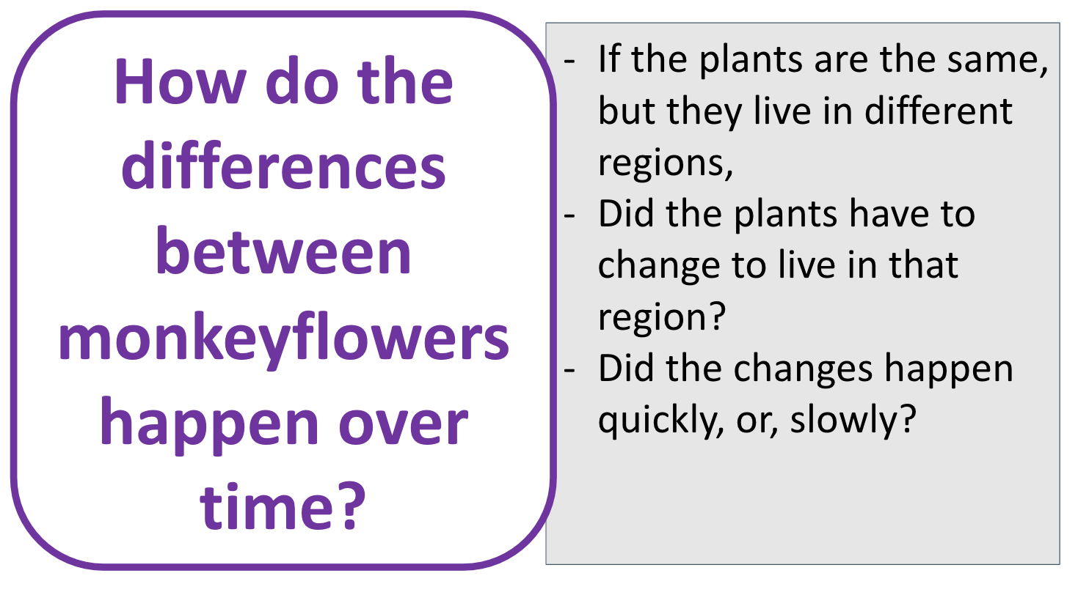
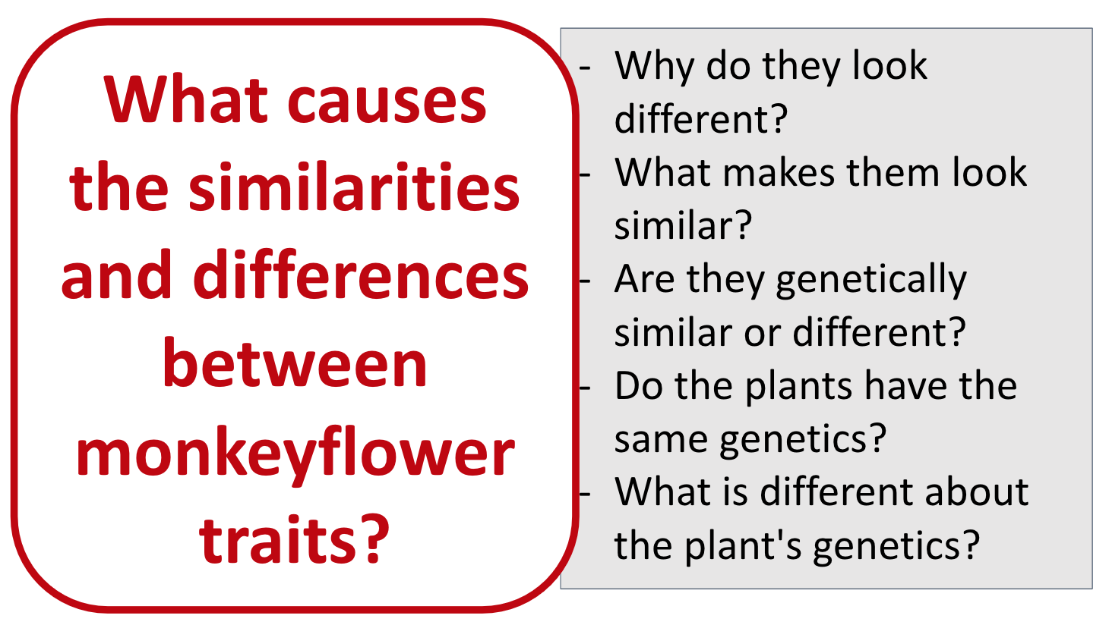
What causes the similarities and differences between organisms?
develop
Notes:
Sample Driving Question Flowchart

Slide 3
What causes the similarities and differences between organisms?

